Slide 1
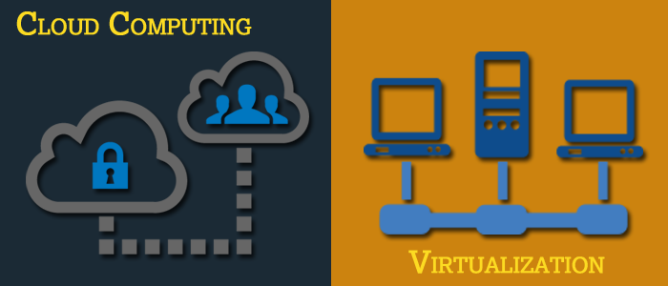
Basics of Virtualization and Cloud Technology

Slide 2
Chapter 5: Introduction to Cloud Computing

Slide 3
Introduction to Cloud Computing
History and Evolution of Cloud Computing
Cloud Deployment Models
Cloud Computing Architecture
Cloud Computing Infrastructure
Merits of Cloud Computing

Slide 4
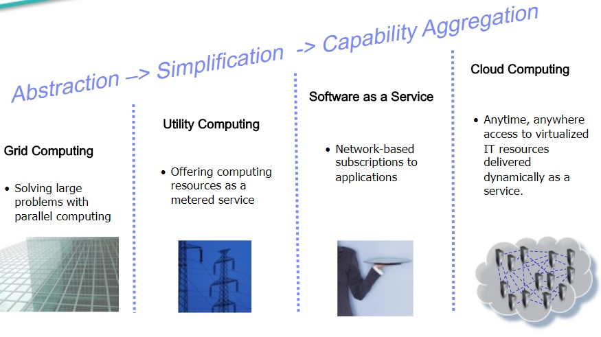
History of Cloud Computing
http://slideplayer.com/slide/5272594/
Notes:
When we think of cloud computing, we think of situations, products and ideas that started in the 21st century. This is not exactly the whole truth. Cloud concepts have existed for many years. Following will brief about the history of cloud computing.
It was a gradual evolution that started in the 1950s with mainframe computing.
Multiple users were capable of accessing a central computer through dumb terminals, whose only function was to provide access to the mainframe. Because of the costs to buy and maintain mainframe computers, it was not practical for an organisation to buy and maintain one for every employee. Nor did the typical user need the large (at the time) storage capacity and processing power that a mainframe provided. Providing shared access to a single resource was the solution that made economical sense for this sophisticated piece of technology.
Around 1970, the concept of virtual machines (VMs) was created.
Using virtualization software, such as, VMware, it became possible to execute one or more operating systems simultaneously in an isolated environment. Complete computers (virtual) could be executed inside one physical hardware which in turn can run a completely different operating system.
The VM operating system took the 1950s’ shared access mainframe to the next level, permitting multiple distinct computing environments to reside on one physical environment. Virtualization came to drive the technology and was an important catalyst in the communication and information evolution.
In the 1990s, telecommunications companies started offering virtualized private network connections.
Historically, telecommunications companies only offered single dedicated point–to-point data connections. The newly offered virtualized private network connections had the same service quality as their dedicated services at a reduced cost. Instead of building out physical infrastructure to allow for more users to have their own connections, telecommunications companies were now able to provide users with shared access to the same physical infrastructure.
The following list briefly explains the evolution of cloud computing:
• Grid Computing: Solving large problems with parallel computing • Utility Computing: Offering computing resources as a metered service • SaaS: Network-based subscriptions to applications • Cloud Computing: Anytime, anywhere access to IT resources delivered dynamically as a service

Slide 5
Six Computing Paradigms
Source: HandBook of Cloud Computing by B. Furht and A Escalante
Notes:
In phase 1: Many users shared powerful mainframes using dummy terminals.
In phase 2: Stand-alone PCs became powerful enough to meet the majority of users’ needs.
In phase 3: PCs, laptops, and servers were connected together through local networks to share resources and increase performance.
In phase 4: Local networks were connected to other local networks forming a global network, such as, the Internet to utilise remote applications and resources.
In phase 5: Grid computing provided shared computing power and storage through a distributed computing system.
In phase 6: Cloud computing further provides shared resources on the Internet in a scalable and simple way.
Comparing these six computing paradigms, it looks like cloud computing is a return to the original mainframe computing paradigm. However, these two paradigms have several important differences. Mainframe computing offers finite computing power, while cloud computing provides almost infinite power and capacity. In addition, in mainframe computing dummy terminals act as user interface devices, while in cloud computing powerful PCs can provide local computing power
and cashing support.

Slide 6
Evolution of Cloud Computing
Cloud computing is a process that necessitates accessing of services, such as, storage, applications and servers through the Internet.
Cloud computing has its roots as far back in 1950s when mainframe computers came into existence.
The 1990s witnessed telecom operators begin offering virtualized private network connections, whose quality of service was as good as those of point-to-point (dedicated) services at a lesser cost.
This paved way for telecom companies' to offer many users shared access to a single physical infrastructure.
Grid computing allowed major issues to be addressed via parallel computing.
Utility computing facilitated computing resources to be offered as a metered service
SaaS allowed subscriptions, which were network-based, to applications. Cloud computing, therefore, owes its emergence to all these factors.
Source: https://dzone.com/articles/cloud-computing-1
Notes:
Cloud computing is a process that necessitates accessing of services, such as, storage, applications and servers through the Internet: This enables an organisation to store and access data or programs virtually in a cloud, rather than on local hard drives or servers.
Cloud computing has its roots as far back in 1950s when mainframe computers came into existence: In 1970s, IBM came out with an operating system (OS) named VM. This allowed for simultaneous operation of more than one OS. Guest Operating Systems could be run on every VM, with their own memory and other infrastructure, making it possible to share these resources. This caused the concept of virtualization in computing to gain popularity.

Slide 7
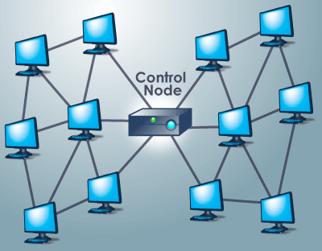
Grid Computing
Grid computing is the collection of computer resources from multiple locations to reach a common goal. The grid can be thought of as a distributed system with non-interactive workloads that involve a large number of files. Grid computing is distinguished from conventional high-performance computing systems, such as, cluster computing in that grid computers have each node set to perform a different task/application.
Why Grid Computing?
40% Mainframes are idle
90% UNIX servers are idle
0-15% Mainframes are idle in peak hour
70% PC servers are idle in peak hour
Source: “Grid Computing” Dr Daron G Green

Slide 8
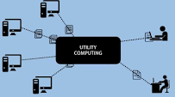
Utility Computing
Utility computing is a service provisioning model in which a service provider makes computing resources and infrastructure management available to the customer as needed, and charges them for specific usage rather than a flat rate.
IBM, HP and Microsoft were early leaders in the new field of utility computing, with their business units and researchers working on the architecture, payment and development challenges of the new computing model. Google, Amazon and others started to take the lead in 2008, as they established their own utility services for computing, storage and applications.
Why Utility Computing?
Utility computing helps eliminate data redundancy, as huge volumes of data are distributed across multiple servers or backend systems. The client however, can access the data anytime and from anywhere.
Source: http://searchdatacenter.techtarget.com/definition/utility-computing

Slide 9
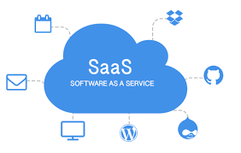
Software as a service
Software as a service (SaaS) is a software licensing and delivery model in which software is licensed on a subscription basis and is centrally hosted.
It is sometimes referred to as "on-demand software“. It is typically accessed by users using a thin client via a web browser.
Why Software as a service?
Software as a service is an alternative to the standard software installation in the business environment (traditional model) where a user has to build the server, install the application and configure it.
In SaaS, a user does not pay for the software itself. Instead, it works like a rental. They have the authorization to use it for a period of time and pay for the software that they are using.
Source: https://www.maximumcomputer.com/glossary/software-as-a-service-saas/
Notes:
SaaS has become a common delivery model for many business applications, including office software, messaging software, payroll processing software, DBMS software, management software, customer relationship management (CRM), Management Information Systems (MIS), enterprise resource planning (ERP) and others.

Slide 10
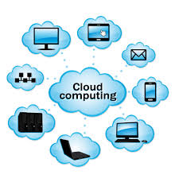
Cloud Computing
Cloud Computing NIST Definition
Cloud computing is a model for enabling ubiquitous, convenient, on-demand network access to a shared pool of configurable computing resources (for example, networks, servers, storage, applications and services) that can be rapidly provisioned and released with minimal management effort or service provider interaction.“
The NIST definition lists five essential characteristics of cloud computing:
On-demand self-service
Broad network access
Resource pooling
Rapid elasticity or expansion
Measured service
Source: https://www.nist.gov/news-events/news/2011/10/final-version-nist-cloud-computing-definition-published

Slide 11
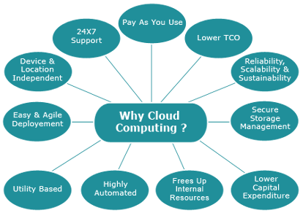
Why Cloud Computing?
Cloud computing is computing based on the Internet. Where in the past, people would run applications or programs from software downloaded on a physical computer or server in their building; cloud computing allows people access to the same kinds of applications through the Internet.
For instance, when you update your Facebook status, you are using cloud computing. Checking your bank balance on your phone? You are in the cloud again. Chances are you rely on cloud computing to solve the challenges faced by small businesses, whether you are firing off emails on the move or using a bunch of apps to help you manage your workload.
Source: https://www.salesforce.com/uk/blog/2015/11/why-move-to-the-cloud-10-benefits-of-cloud-computing.html

Slide 12
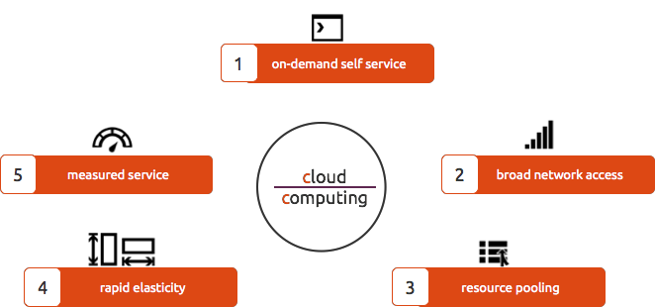
Five Essential Characteristics of Cloud computing
Source: https://www.nist.gov/sites/default/files/documents/itl/cloud/cloud-def-v15.pdf
Notes:
On-demand Self-service: A consumer can unilaterally provision computing capabilities, such as server time and network storage, as needed automatically without requiring human interaction with each service provider.
Broad Network Access: Capabilities are available over the network and accessed through standard mechanisms that promote use by heterogeneous thin or thick client platforms (for example, mobile phones, tablets, laptops and workstations).
Resource Pooling: The provider's computing resources are pooled to serve multiple consumers using a multi-tenant model, with different physical and virtual resources dynamically assigned and reassigned according to consumer demand. There is a sense of location independence in that the customer generally has no control or knowledge over the exact location of the provided resources but may be able to specify location at a higher level of abstraction for example, country, state or datacentre). Examples of resources include storage, processing, memory and network bandwidth.
Rapid Elasticity: Capabilities can be elastically provisioned and released, in some cases automatically, to scale rapidly outward and inward commensurate with demand. To the consumer, the capabilities available for provisioning often appear to be unlimited and can be appropriated in any quantity at any time.
Measured Service: Cloud systems automatically control and optimise resource use by leveraging a metering capability at some level of abstraction appropriate to the type of service (for example, storage, processing, bandwidth and active user accounts). Resource usage can be monitored, controlled and reported, providing transparency for provider and consumer.

Slide 13
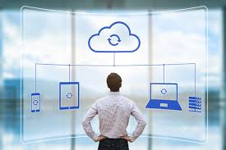
Benefits of Cloud Computing
Flexibility
Disaster Recovery
Automatic Software Updates
More Cost Efficiency
Increased Collaboration
Work from anywhere
Security
Competitiveness
Environmental Friendly

Slide 14

Flexibility
Cloud-based services are ideal for businesses with growing or fluctuating bandwidth demands.
If the needs increase, it is easy to scale up cloud capacity, drawing on the service’s remote servers. Likewise, if the need to be scaled down again, the flexibility is baked into the service.
This level of agility can give businesses using cloud computing a real advantage over competitors.
Source: https://www.salesforce.com/uk/blog/2015/11/why-move-to-the-cloud-10-benefits-of-cloud-computing.html
Notes:
Flexibility
Cloud computing allows your employees to be more flexible — both in and out of the workplace. Employees can access files using web-enabled devices, such as, smartphones, laptops and notebooks. The ability to simultaneously share documents and other files over the Internet can also help support both internal and external collaboration. Many employers are now implementing “bring your own device (BYOD)” policies. In this way, cloud computing enables the use of mobile technology.

Slide 15
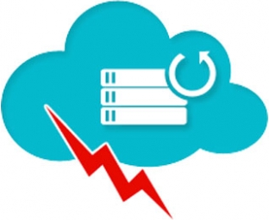
Disaster Recovery
Cloud disaster recovery (cloud DR) is a backup and restore strategy that involves storing and maintaining copies of electronic records in a cloud computing environment as a security measure.
The goal of cloud DR is to provide an organisation with a way to recover data and/or implement failover in the event of a man-made or natural catastrophe.
https://www.salesforce.com/uk/blog/2015/11/why-move-to-the-cloud-10-benefits-of-cloud-computing.html

Slide 16
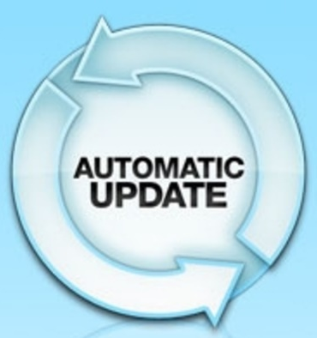
Automatic Software Updates
Cloud suppliers do all the server maintenance required with cloud computing, including security updates. This frees up employees, IT staff and resources for other tasks.
Source: https://www.salesforce.com/uk/blog/2015/11/why-move-to-the-cloud-10-benefits-of-cloud-computing.html

Slide 17

More Cost Efficiency
Cloud computing cuts out the high cost of hardware. User simply pay as you go and enjoy a subscription-based model. Most cloud services are paid on a subscription basis, so capital expenditure is reduced.

Slide 18
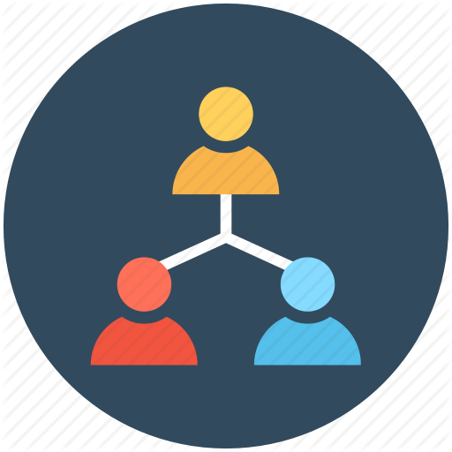
Increased Collaboration
When the project teams can access, edit and share documents anytime, from anywhere, they are able to do more together and do it better
Cloud-based workflow and file sharing apps help them make updates in real time and gives them full visibility of their collaborations
Source: https://www.salesforce.com/uk/blog/2015/11/why-move-to-the-cloud-10-benefits-of-cloud-computing.html

Slide 19
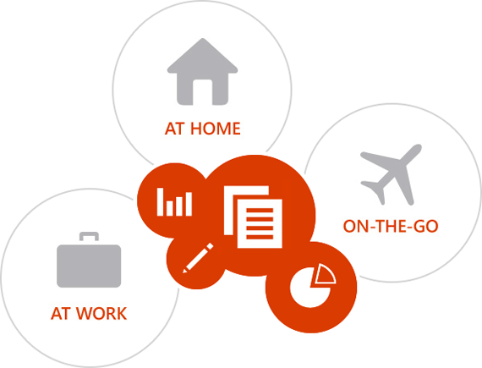
Work from Anywhere
With cloud computing, if user have got an internet connection, he/she can be at work from anywhere.
And with most serious cloud services offering mobile apps, users’ are not restricted by which device they have got to hand.

Slide 20
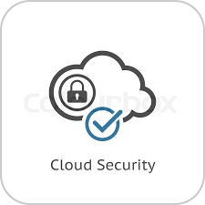
Increased Security
cloud security is a broad set of policies, technologies, and controls deployed to protect data, applications, and the associated infrastructure of cloud computing. It is a sub-domain of computer security, network security
According to Alert Logic’s State of Cloud Security Report, on-premise server users actually suffer more security incidents than those of cloud service providers.
https://www.salesforce.com/uk/blog/2015/11/why-move-to-the-cloud-10-benefits-of-cloud-computing.html

Slide 21

Competitiveness
Wish there was a simple step for user that could take to become more competitive? Moving to the cloud gives access to enterprise-class technology, for everyone. It also allows smaller businesses to act faster than big and established competitors.
Source: https://www.salesforce.com/uk/blog/2015/11/why-move-to-the-cloud-10-benefits-of-cloud-computing.html

Slide 22

Environment Friendly
The environment gets a little love too. When your cloud needs fluctuate, your server capacity scales up and down to fit. So you only use the energy you need and you don’t leave oversized carbon footprints.
Source: https://www.salesforce.com/uk/blog/2015/11/why-move-to-the-cloud-10-benefits-of-cloud-computing.html

Slide 23
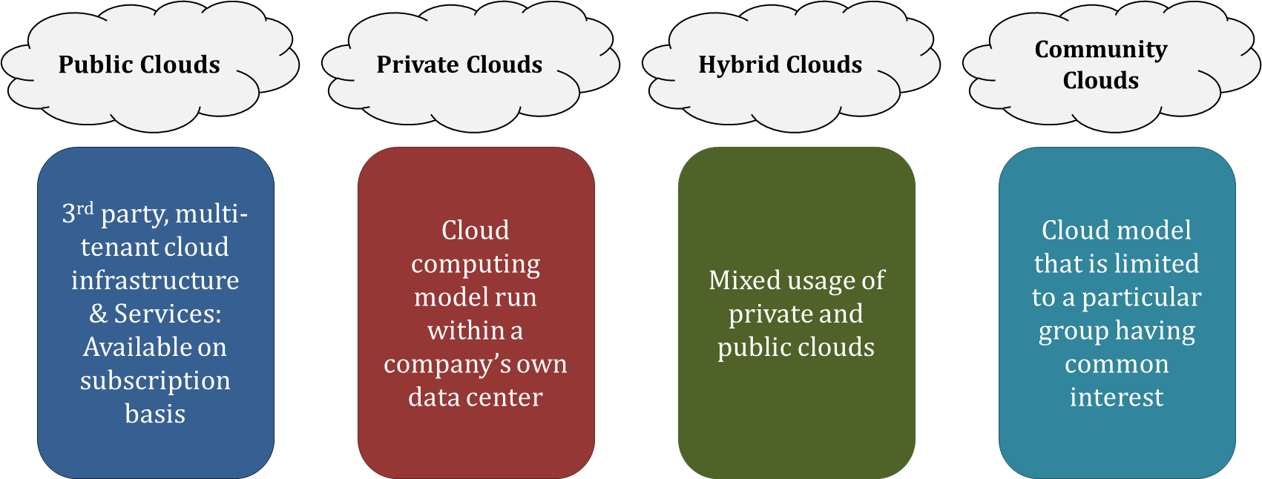
Cloud Deployment Models
The cloud deployment model specifies the location and management of a cloud’s infrastructure. Based on the deployment, we can broadly classify cloud computing users into four categories, namely, public cloud, private cloud, hybrid cloud and community cloud.

Slide 24
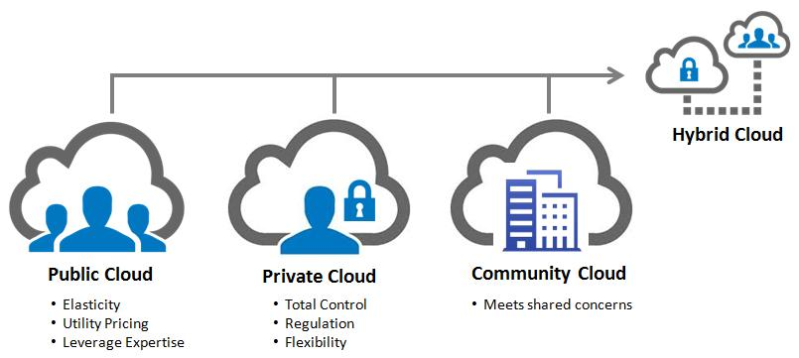
Public Cloud
A public cloud is one based on the standard cloud computing model, in which a service provider makes resources, such as, virtual machines (VMs), applications or storage, available to the general public over the Internet. Public cloud services may be free or offered on a pay-per-usage model.
Benefits of Using a Public Cloud
It reduces the need for organisations to invest in and maintain their own on-premise IT resources.
It enables scalability to meet workload and user demands.
There are fewer wasted resources because customers only pay for the resources they use.
Examples of Public Clouds include: Amazon Elastic Compute Cloud (EC2), IBM’s Blue Cloud, Sun Cloud, Google AppEngine and Windows Azure Services Platform
For users, these types of clouds will provide the best economies of scale, are inexpensive to set-up because hardware, application and bandwidth costs are covered by the provider. It’s a pay-per-usage model and the only costs incurred are based on the capacity that is used.
There are some limitations, however; the public cloud may not be the right fit for every organisation. The model can limit configuration, security and SLA specificity, making it less-than-ideal for services using sensitive data that is subject to compliance regulations.

Slide 25
Private Cloud
Private cloud is a type of cloud computing that delivers similar advantages to public cloud, including scalability and self-service, but through a proprietary architecture. Unlike public clouds, which deliver services to multiple organisations, a private cloud is dedicated to the needs and goals of a single organisation.
Private clouds are datacenter architectures owned by a single company that provides flexibility, scalability, provisioning, automation and monitoring. The goal of a private cloud is not sell “as-a-service” offerings to external customers but instead to gain the benefits of cloud architecture without giving up the control of maintaining your own data centre.
Private clouds can be expensive with typically modest economies of scale. This is usually not an option for the average small-to-medium sized businesses and is most typically put to use by large enterprises. Private clouds are driven by concerns around security and compliance and keeping assets within the firewall.
Examples of Private Clouds are VMware Vsphere/Vcenter, OpenStack, Citrix CloudStack, Eucalyptus, Microsoft System Center

Slide 26
Benefits of Private Cloud
Dedicated hardware means increased security.
The transition from physical to virtual servers leads to better flexibility.
Utilise your hardware complexly with better resource management.
Virtual servers combined with a SAN allows for improved protection against disasters.
Switching to private cloud computing will save you time and money.
Source: http://www.onlinetech.com/resources/references/top-5-reasons-why-your-company-should-transition-to-private-cloud-computing
Notes:
Dedicated hardware means increased security.
Much like a dedicated or collocated server, the security of your private cloud depends on a variety of factors. However, if you have the proper physical security, anti-virus software and firewall rules in place, you can be rest assured your data will be safe as if it were sitting right next to your desk. With a private cloud, you know where your servers are located and that the proper physical and network security is in place. You can meet and talk to those in charge of providing support for your hardware and come visit it if you like.
The transition from physical to virtual servers leads to better flexibility.
This is one of the most alluring benefits of cloud computing. The ability to spin up and tear down a server in a matter of minutes is incredibly powerful and useful. No longer is there any wasted effort in trying to size a server beforehand when you can create a server on the fly. Need more disk space? More RAM? More CPU? No problem. With private cloud computing, you can reallocate resources in moments without worrying about finding a physical server that will have the resources your new server needs.
Utilise your hardware completely with better resource management.
Virtualization significantly increases the value of your physical server hardware. Instead of having 5 servers that average 10% CPU utilisation, you can virtualize the 5 servers on one physical server, sharing the resources. This decreases rack space, power usage, and is easier to manage. This also allows you to create copies of your servers and have them up and running very quickly, now that they have been virtualized. If you have the proper resource management tools installed on your server, you can automatically allocate the appropriate resources to a server when it needs it or turn off unused servers during low usage; an extraordinarily powerful and efficient way to manage your servers.
Virtual servers combined with a SAN allows for improved protection against disasters.
When you connect a SAN to your private cloud, incredible redundancy can be achieved. Not only can you load balance between servers, automatically shifting server resources between servers on the fly, but in an N+1 environment (having at least 1 extra server than absolutely necessary), you can shut down one server without causing downtime. Imagine performing maintenance on your server like adding more RAM, replacing a hard drive, or upgrading software, without experiencing any downtime. When configured correctly you could power off one server and it would automatically shift the virtual servers over to an available server in your cloud. Taking your disaster protection up one level, you could have another SAN in another data centre and perform SAN to SAN replication for a hot site DR environment capable of full recovery in less than 1 hour.
Switching to private cloud computing will save you time and money.
The best part about a private cloud is that not only do you get all of the great benefits of virtualization and security, but it can be cheaper and less of a hassle then hosting your own servers or buying dedicated servers. If your company has more than 2 servers, it could benefit from virtualization. If your company has more than 10 servers, it could benefit from private cloud computing with a dedicated SAN and multiple physical host servers. The public cloud revolutionised Information Technology forever; the private cloud brings the benefits to the masses.

Slide 27
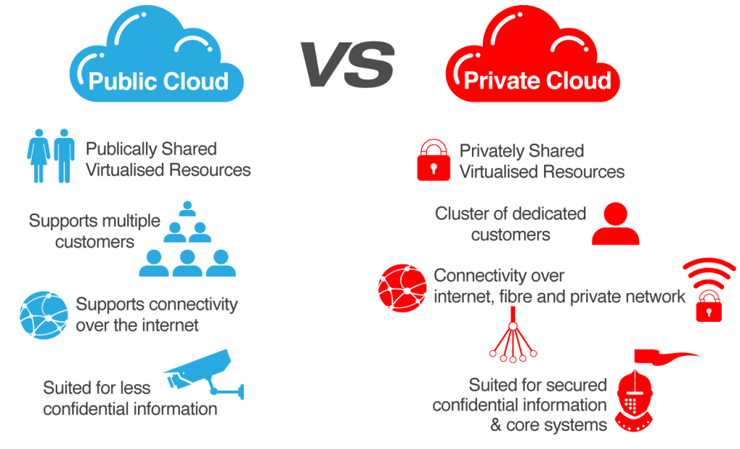
Difference between Public and Hybrid Cloud
Source: http://www.fiber-optic-transceiver-module.com/will-hybrid-cloud-replace-the-public-private-clouds.html
Notes:
Difference between Public and Private Cloud
Parameters Public Cloud Private Cloud
Agility New Server in minutes New Server in 6-20 weeks
Capacity Elastic Fixed
Cost Lower Higher
Expense Variable Fixed
Global Go global in minutes Reach limited by footprint
IT Higher value Undifferentiated work

Slide 28
Hybrid Cloud
Hybrid cloud is a cloud computing environment which uses a mix of on-premises, private cloud and third-party, public cloud services with orchestration between the two platforms.
By allowing workloads to move between private and public clouds as computing needs and costs change, hybrid cloud gives businesses greater flexibility and more data deployment options.
For example, an enterprise can deploy an on-premises private cloud to host sensitive or critical workloads, but use a third-party public cloud provider, such as Google Compute Engine, to host less-critical resources, such as test and development workloads.
To hold customer-facing archival and backup data, a hybrid cloud could also use Amazon Simple Storage Service (Amazon S3). A software layer, such as Eucalyptus, can facilitate private cloud connections to public clouds, such as, Amazon Web Services (AWS).
Source: http://searchcloudcomputing.techtarget.com/definition/hybrid-cloud
Notes:
Hybrid cloud is particularly valuable for dynamic or highly changeable workloads. For example, a transactional order entry system that experiences significant demand spikes around the holiday season is a good hybrid cloud candidate. The application could run in private cloud, but use cloud busting to access additional computing resources from a public cloud when computing demands spike. To connect private and public cloud resources, this model requires a hybrid cloud environment.
Another hybrid cloud use case is big data processing. A company, for example, could use hybrid cloud storage to retain its accumulated business, sales, test and other data, and then run analytical queries in the public cloud, which can scale to support demanding distributed computing tasks.

Slide 29
Community Cloud
A community cloud is a cloud service model that provides a cloud computing solution to a limited number of individuals or organisations that is governed, managed and secured commonly by all the participating organisations or a third party managed service provider.
Community clouds are a hybrid form of private clouds built and operated specifically for a targeted group. These communities have similar cloud requirements and their ultimate goal is to work together to achieve their business objectives.
Community clouds are often designed for businesses and organisations working on joint projects, applications or research, which requires a central cloud computing facility for building, managing and executing such projects, regardless of the solution rented.
Source: https://www.techopedia.com/definition/26559/community-cloud

Slide 30
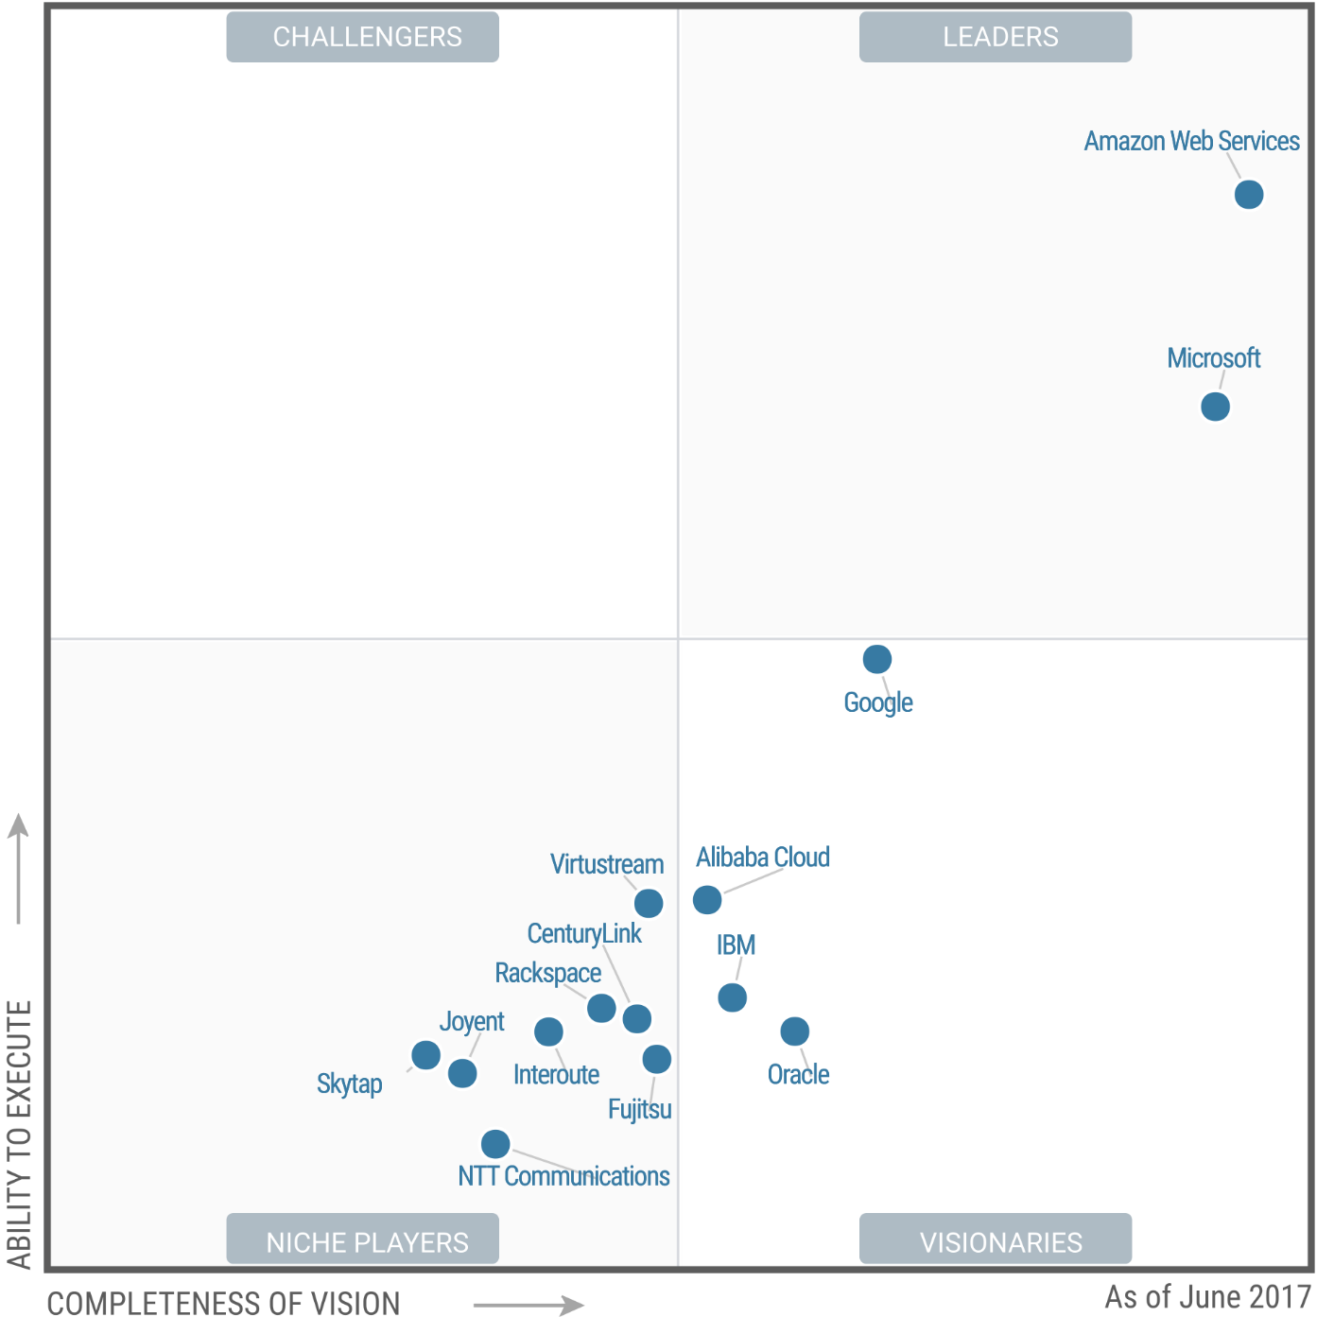
Gartner’s Magic Quadrant of Cloud Infrastructure Worldwide 2017
Source: https://regmedia.co.uk/2017/06/18/gartner_iaas_mq_june_2017.png

Slide 31
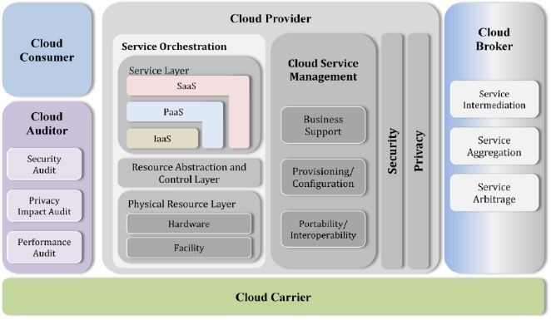
Cloud Computing Architecture
The overview of the reference architecture shown in the below figure describes five major actors with their roles and responsibilities using the newly developed Cloud Computing Taxonomy. The five major participating actors are the Cloud Consumer, Cloud Provider, Cloud Broker, Cloud Auditor and Cloud Carrier.
Source: NIST cloud computing reference architecture
Notes:
The NIST cloud computing reference architecture focuses on the requirements of “what” cloud services provide, not a “how to” design solution and implementation. The reference architecture is intended to facilitate the understanding of the operational intricacies in cloud computing. It does not represent the system architecture of a specific cloud computing system; instead it is a tool for describing, discussing, and developing a system-specific architecture using a common framework of reference.

Slide 32
Actors in Cloud Computing
Table Showing the Actors in Cloud Computing
Actor | Definition
Cloud Consumer | A person or organisation that maintains a business relationship with, and uses service from Cloud Providers.
Cloud Provider | A person, organisation, or entity responsible for making a service available to interested parties.
Cloud Auditor | A party that can conduct independent assessment of cloud services, information system operations, performance and security of the cloud implementation.
Cloud Broker | An entity that manages the use, performance and delivery of cloud services, and negotiates relationships between Cloud Providers and Cloud Consumers.
Cloud Carrier | An intermediary that provides connectivity and transport of cloud services from Cloud Providers to Cloud Consumers.
Source: https://www.nist.gov/sites/default/files/documents/itl/cloud/NIST_SP-500-291_Jul5A.pdf

Slide 33
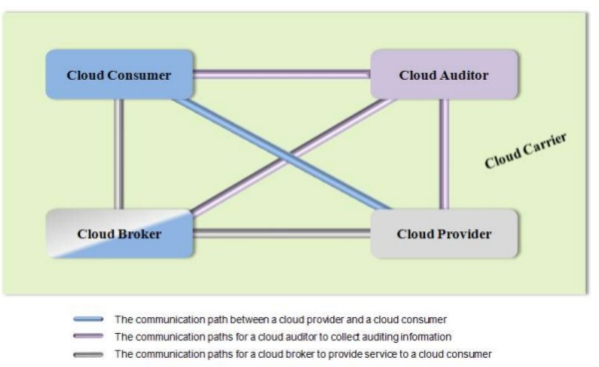
Interactions Between the Actors in Cloud Computing
Source: NIST Cloud Computing Reference Architecture

Slide 34
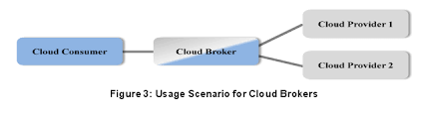
Use Case 1
A cloud consumer may request service from a cloud broker instead of contacting a cloud provider directly. The cloud broker may create a new service by combining multiple services or by enhancing an existing service. In this example, the actual cloud providers are invisible to the cloud consumer and the cloud consumer interacts directly with the cloud broker.
Source: NIST Cloud Computing Reference Architecture
Source: https://www.nist.gov/sites/default/files/documents/itl/cloud/NIST_SP-500-291_Jul5A.pdf

Slide 35
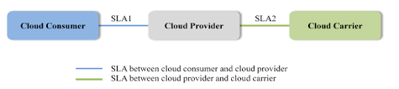
Use Case 2
Cloud carriers provide connectivity and transport of cloud services from cloud providers to cloud consumers. As illustrated in the figure below, a cloud provider participates in and arranges for two unique service level agreements (SLAs), one with a cloud carrier (for example, SLA2) and one with a cloud consumer (for example, SLA1).
Source: NIST Cloud Computing Reference Architecture
Source: https://www.nist.gov/sites/default/files/documents/itl/cloud/NIST_SP-500-291_Jul5A.pdf
Notes:
A cloud provider arranges service level agreements (SLAs) with a cloud carrier and may request dedicated and encrypted connections to ensure the cloud services are consumed at a consistent level according to the contractual obligations with the cloud consumers. In this case, the provider may specify its requirements on capability, flexibility and functionality in SLA2 in order to provide essential requirements in SLA1.

Slide 36
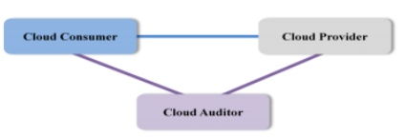
Use Case 3
For a cloud service, a cloud auditor conducts independent assessments of the operation and security of the cloud service implementation. The audit may involve interactions with both the Cloud Consumer and the Cloud Provider.
Source: NIST Cloud Computing Reference Architecture
Source: https://www.nist.gov/sites/default/files/documents/itl/cloud/NIST_SP-500-291_Jul5A.pdf
Notes:
Cloud Consumer
The cloud consumer is the principal stakeholder for the cloud computing service. A cloud consumer represents a person or organisation that maintains a business relationship with, and uses the service from a cloud provider. A cloud consumer browses the service catalogue from a cloud provider, requests the appropriate service, sets up service contracts with the cloud provider and uses the service. The cloud consumer may be billed for the service provisioned and needs to arrange payments accordingly.
Cloud Provider
A cloud provider is a person, an organisation; it is the entity responsible for making a service available to interested parties. A Cloud Provider acquires and manages the computing infrastructure required for providing the services, runs the cloud software that provides the service.
Cloud Auditor
A cloud auditor is a party that can perform an independent examination of cloud service controls with the intent to express an opinion thereon. Audits are performed to verify conformance to standards through review of objective evidence. A cloud auditor can evaluate the services provided by a cloud provider in terms of security controls, privacy impact, performance and others.
Cloud Broker
As cloud computing evolves, the integration of cloud services can be too complex for cloud consumers to manage. A cloud consumer may request cloud services from a cloud broker, instead of contacting a cloud provider directly. A cloud broker is an entity that manages the use, performance and delivery of cloud services and negotiates relationships between cloud providers and cloud consumers.
Cloud Carrier
A cloud carrier acts as an intermediary that provides connectivity and transport of cloud services between cloud consumers and cloud providers. Cloud carriers provide access to consumers through network, telecommunication and other access devices.

Slide 37
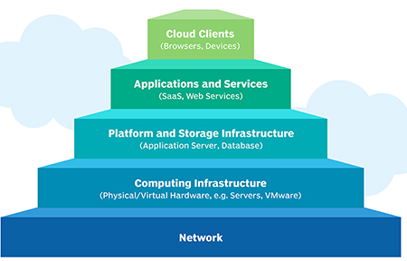
Cloud Computing Infrastructure
Cloud infrastructure refers to the hardware and software components, such as servers, storage, a network and virtualization software that are needed to support the computing requirements of a cloud computing model.
Cloud infrastructure also includes an abstraction layer that virtualizes resources and logically presents them to users through application program interfaces and API-enabled command-line or graphical interfaces.
Source: http://searchcloudcomputing.techtarget.com/definition/cloud-infrastructure
Notes:
In cloud computing, these virtualized resources are hosted by a service provider or IT department and are delivered to users over a network or the Internet. These resources include virtual machines and components, such as servers, memory, network switches, firewalls, load balancers and storage.
Cloud Infrastructure Components
In a cloud computing architecture, cloud infrastructure refers to the back-end components -- the hardware elements found within most enterprise data centres. These include multisocket, multicore servers, persistent storage and local area network equipment, such as switches and routers -- but on much greater scale.
Major public cloud providers, such as, Amazon Web Services (AWS) or Google Cloud Platform, offer services based on shared, multi-tenant servers. This model requires massive compute capacity to handle both unpredictable changes in user demand and to optimally balance demand across fewer servers. As a result, cloud infrastructure typically consists of high-density systems with shared power.
Cloud Infrastructure as a Service
While cloud infrastructure is the hardware and software components required for cloud computing; Infrastructure as a Service (IaaS) is a cloud model that gives organisations the ability to rent those IT infrastructure components -- including compute, storage and networking -- over the internet from a public cloud provider. This public cloud service model is often referred to as IaaS.

Slide 38
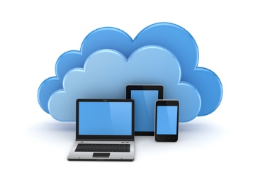
Merits of Cloud Computing
Cloud computing provides many benefits to its customers. Users can use applications on the cloud at any time and from anywhere.
Some of the major benefits of cloud computing are as follows:
Lower cost
Ease of utilisation
Quality of service
Reliability
Availability
Outsourced IT management
Simplified maintenance and upgrade
Low barrier to entry
Flexibility
Return on Investment (ROI)
Environment-friendly computing
Notes:
Merits of Cloud Computing
Lower Costs: Cloud networks provide greater resource utilisation and efficiency, resulting in cost reduction. Cloud computing allows users to pay less for the use of applications on the cloud. It also reduces the up-front investment. Ownership and operational cost is also reduced.
Ease of Utilisation: Based on the type of cloud service selected, a user does not need hardware or software licenses to implement services.
Quality of Service: A user can get quality of service from cloud service providers.
Reliability: The ability of a cloud computing system in load balancing and backup data during failures makes them highly reliable.
Availability: A cloud provides consistent service for users.
Outsourced IT Management: In cloud computing, someone else manages your computing infrastructure when you manage your business. This helps reduce IT staffing costs.
Simplified Maintenance and Upgrade: In cloud computing, users always have access to the latest software versions and since the system is centralised, users can easily apply patches and upgrades.
Low Barrier to Entry: In cloud computing, anyone can be a giant at any time due to lower capital expenditure.
Flexibility: A cloud also offers flexibility so that a user can work on the same project from anywhere in the world.
Return on Investment: A cloud offers increased return on investment of existing assets.
Environment-friendly Computing: Cloud computing only uses server space required by the application; this reduces security issues as well as carbon footprints.

Slide 39
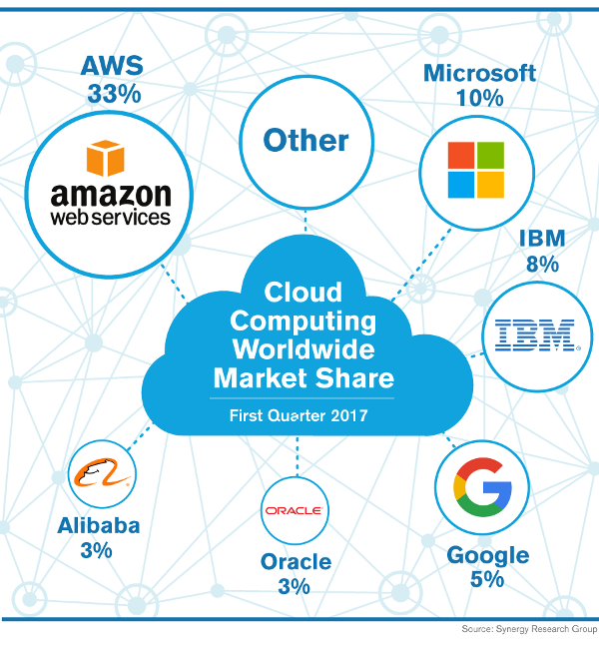
Cloud Market Share
Source: Synergy Research Group

Slide 40
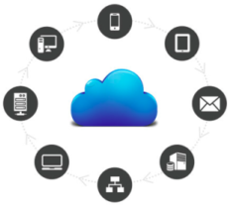
Use Cases of Cloud Computing
The shift to the cloud has brought about several solutions that make doing business easier. There are several use cases that have undeniable benefits and should not be ignored. Following are some of the use cases of cloud computing:
Software as a Service (SaaS)
Big data analytics
Software-defined wide area networking (SD-WAN)
Private/public/hybrid cloud
Infrastructure as a Service (IaaS)
Test and development
Virtual desktops (VDI)/Desktop as a Service
Email
Disaster as a Service (DRaaS)
Backup as a Service (BaaS)
Source: http://blog.newcloudnetworks.com/the-top-10-use-cases-for-cloud-computing
Notes:
Software as a Service (SaaS)
As companies grow and gather more data, SaaS technology has entered the market as a way to store, organise and maintain that data. Marketing automation tools, customer relationship management (CRM) and others have helped lines of business to more efficiently do their jobs. Often referred to as "software on demand," SaaS solutions are centrally hosted in the cloud and can be accessed from anywhere, any time.
Big Data Analytics
Speaking of gathering more data, Big Data is a disruptive trend that is wreaking havoc on the business world. Companies, such as, Amazon and Facebook are Big Data powerhouses, collecting information on consumer buying trends, likes, dislikes and analysing the data to predict future purchases and grow their businesses. Companies today are trying to collect and understand big data to make decisions on sales, marketing, R&D and more. When it comes to storing, managing and analysing this data, the cloud is a very powerful tool.
Software-Defined Wide Area Networking (SD-WAN)
One of the major issues related to cloud solutions is that companies make investments without considering the underlying network and bandwidth needed to operate a solution. SD-WAN has emerged to resolve the issue of bogged down networking due to cloud applications. SD-WAN integrates with your existing network solution to speed up your connectivity, addressing a major issue that is underrated.
Private/Public/Hybrid Cloud
Though the word "cloud" is rather ambiguous, the important thing to remember is that the cloud is essentially someone else's computer. Companies can host data in 3 different types of cloud environments: Public, private and hybrid. Choosing which cloud solution is right for your business is ultimately up to need specific to your company. Typically, larger companies with larger budgets for building and maintaining of an on-site data centre will choose a private or hybrid cloud solution, due to its protection of private information. Smaller to mid-sized businesses might choose a public cloud, as it is a simpler, more cost-effective solution to hosting data.
Infrastructure as a Service (IaaS)
There is a lot that goes into building and maintaining infrastructure. There's the hardware costs, the cost of the space, the electricity to power it, and the overhead to build and maintain it. Building out a data centre can easily cost a company millions of dollars. For this reason, companies are opting forego capital expenditures in favour of operational expenditures and host data in service provider run data centres. This allows companies to avoid costly infrastructure investments and easily access their data via the cloud.
Test and Development
The flexibility of the cloud allows for environments to be built up, tested and torn down quickly. There is no need to wait months for the provisioning of a new environment, the cloud can be spun up in a matter of minutes. The accessibility of the cloud means that your business is more efficient and time to market for new developments can be cut down.
Virtual Desktops (VDI) / Desktop as a Service (DaaS)
With the mobile workforce growing in prevalence, employees are increasingly bringing their own devices. Virtual desktops and DaaS have emerged as a way for IT departments to standardise security and content access across devices. VDI and DaaS help to curb the effects of a disaster because they are hosted in the cloud and can be easily accessed from any device.
Email
Falling along the category of SaaS, email is a technology that has been around for quite some time. Accessed via the Internet, common clients ( such as, Microsoft's Outlook) are ingrained in core business processes. Whether its marketing, sales or IT, email has a use case in every line of business, and its accessibility via the cloud is crucial.
Disaster Recovery as a Service (DRaaS)
Quickly become one of the core use cases for cloud computing, disaster recovery is critical to every business. With downtime causing companies to lose time and money, DR works to ensure your business can quickly recover and get back online in the event of a disaster. By having a standby site in the cloud for DR purposes, failover is quick and easy and does not require you to build and maintain your own infrastructure.
Backup as a Service (BaaS)
One of the easiest ways to begin your shift to the cloud is to invest in a backup solution. IT professionals know that having just one copy of your data onsite opens you up to vulnerabilities in the event of a disaster. Following the 3-2-1 rule — having 3 copies of your data on 2 different media and 1 offsite — is the best way to ensure your data is safe and secure. The cloud is where that offsite piece comes in. Restoring backups from the cloud is fast and can help companies avoid catastrophic data loss.

Slide 41
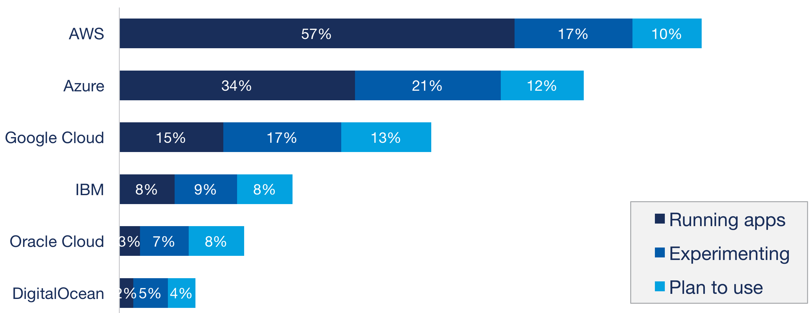
Public Cloud Adoption
Source: RightScale 2017 State of the Cloud Report
Notes:
Amazon Web Services (AWS)
AWS was launched in 2006 from the internal infrastructure that Amazon.com built to handle its online retail operations. AWS was one of the first companies to introduce a pay-as-you-go cloud computing model that scales to provide users with compute, storage or throughput as needed.
Amazon Web Services provides services from dozens of data centres spread across availability zones (AZs) in regions across the world. An AZ represents a location that typically contains multiple physical data centres, while a region is a collection of AZs in geographic proximity connected by low-latency network links. An AWS customer can spin up virtual machines (VMs) and replicate data in different AZs to achieve a highly reliable infrastructure that is resistant to failures of individual servers or an entire data centre.
Azure
Microsoft Azure, formerly known as Windows Azure, is Microsoft's public cloud computing platform. It provides a range of cloud services, including those for compute, analytics, storage and networking. Users can pick and choose from these services to develop and scale new applications, or run existing applications, in the public cloud.
Google Cloud
Google Cloud Platform, offered by Google, is a suite of cloud computing services that runs on the same infrastructure that Google uses internally for its end-user products, such as Google Search and YouTube. Alongside a set of management tools, it provides a series of modular cloud services including computing, data storage, data analytics and machine learning.
IBM Cloud
IBM cloud computing is a set of cloud computing services for business offered by the information technology company IBM. IBM cloud includes infrastructure as a service (IaaS), software as a service (SaaS) and platform as a service (PaaS) offered through public, private and hybrid cloud delivery models, in addition to the components that make up those clouds.
Oracle Cloud
Oracle Cloud is a cloud computing service offered by Oracle Corporation providing servers, storage, network, applications and services through a global network of Oracle Corporation managed data centres. The company allows these services to be provisioned on demand over the Internet.
Oracle Cloud provides Infrastructure as a Service (IaaS), Platform as a Service (PaaS), Software as a Service (SaaS) and Data as a Service (DaaS). These services are used to build, deploy, integrate and extend applications in the cloud.
Digital Ocean
DigitalOcean, Inc. is an American cloud infrastructure provider headquartered in New York City with data centres worldwide. DigitalOcean provides developers cloud services that help to deploy and scale applications that run simultaneously on multiple computers.

Slide 42


